Slide 1
A2 Use of Maths Module USE2 coursework Lesson 3

Slide 2

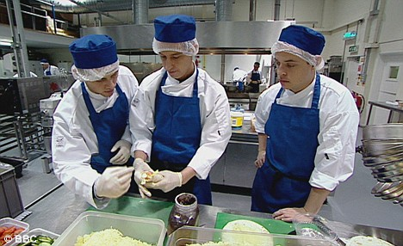
Any guesses who these people are?
Why am I getting you to think about these pictures?

Slide 3

Any guesses who these people are?
Why am I getting you to think about these pictures?

Slide 4
Formatting
Each piece of coursework must eventually be submitted as a paper document.
Your class teacher will expect to see intermediate electronic copies of your coursework in progress.
You are allowed to include handwritten work – but it might be worth considering scanning or photographing the work so that you have a spare copy (in case the sheet is lost before hand in)

Slide 5
Formatting
As a general rule, imagine that your coursework is a report that you are producing for your boss at work.
It therefore needs formal professional language, good spelling, and grammar.
You should also put the information into a sensible structure, with section headings and sub-headings (to make it easier for someone to follow your work – and for the examiner to find where to award marks)

Slide 6
Formatting
The exam board do not specify any particular formatting style, but the following are good ideas:
Headers containing your Name and Candidate number (maybe also the title)
Footers containing page numbers (so that if a page gets separated from your document after submission, the examiner knows to look for it)
Title page If you have time to add a Title page, (maybe including a few relevant illustrations), it can make the work more appealing to read.

Slide 7
Backups
Every year, one or two LR students accidentally lose some or all of their coursework – either by leaving a pen drive somewhere, overwriting earlier work or losing some sheets of paper. Unfortunately this is not a valid reason for an extension to the deadline.
To avoid this happening, keep electronic copies of everything – and email a copy to yourself after each significant new piece of work.

Slide 8
References
You must mention any information used in your coursework that is not your own.
You will therefore need to add references in your text and/or a bibliography at the end. Any suitable method will be fine, but a standard method is called “Harvard Referencing” (after the American University).

Slide 9
Harvard Referencing
In-text citations – at the point in the text where you mention something from someone else… give the author and date of the source document in brackets.
Eg. I will be conducting a survey to see if people tend to get more books as they get older – as implied in the quote “One can never have enough socks," said Dumbledore. "Another Christmas has come and gone and I didn't get a single pair. People will insist on giving me books.” (Rowling, 1997)
Reference – at the end of the document, a list of the citations used with more information.
Eg. JK Rowling 1997 – Harry Potter and the Philosophers Stone

Slide 10
Harvard Referencing
Websites: In the citation, give the name of the organisation or person responsible for the web page. In the reference, you need to give the full http or https address, and the date when you accessed the information (because it might be changed later). (Anglia Ruskin, 2013)
Anglia Ruskin University, 2013. Harvard System [online] available at <http://libweb.anglia.ac.uk/referencing/files/QuickHarvardGuide2013Aug.pdf> [accessed 28th May 2014]
If you are using Word, the References tab may help you add references and citations in an appropriate format…

Slide 11
What needs to be referenced?
All source data that you have not personally collected. (Including Googlemaps, ordnance survey maps etc)
Any tables, methods that were not provided/taught by your use of Maths teacher eg. Statistical booklet with methods/tables from Biology coursework. Mymaths for method to calculate line of best fit using Excel. Use of Maths/maths textbooks.
You do not need to reference information in your Use of Maths study packs, things you were told by your Use of Maths class teacher or your own idea/work.
It is a good idea to create the list of references as you use each new piece of information (ie start now while you are researching and collecting data) – don’t leave it to the end and try to remember everything!

Slide 12
Representing information
Either in the main text of your coursework, or in an appendix, you will need to provide the examiner with all of your source data (so that they can check you have calculated accurately).
You will also need to give your answer in a form that the reader will be able to understand what you mean.
The next activity will help us think about ways of representing information…

Slide 13
Representing information
What information can you deduce from each diagram?
Are the diagrams effective in communicating the information?
Are there any diagrams where you think the data is not represented clearly or effectively? How could you improve them?
What stories can be told about the sporting events represented in these graphs and diagrams?

Slide 14
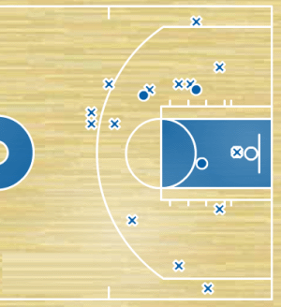
Baskets made (o) and missed (x) in the fourth quarter of a basketball match

Slide 15
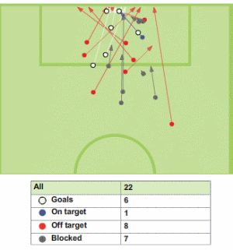
Shots on and off target for one team in a football match

Slide 16
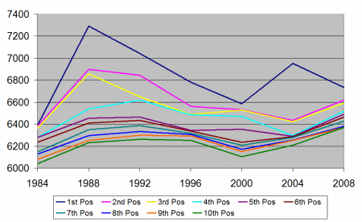
Finishing Scores of top ten athletes in Olympic heptathlon

Slide 17
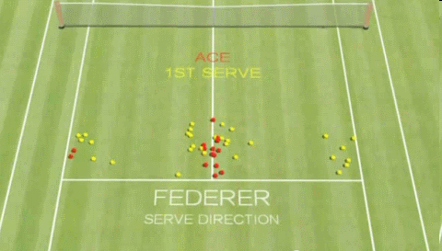
Scatter plot showing Federer's first serve landing points

Slide 18
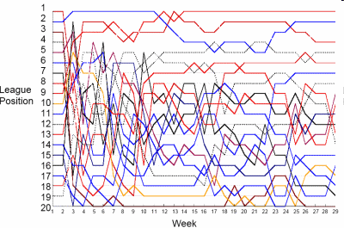
League positions of teams in a football league during a season

Slide 19
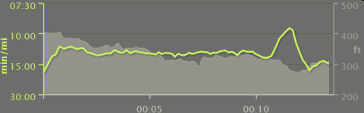
Average speed and altitude of the terrain for a runner's 14 minute workout

Slide 20
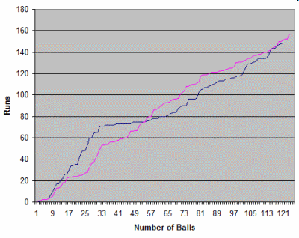
"Worm Graph" showing runs scored by two sides in a game of cricket

Slide 21
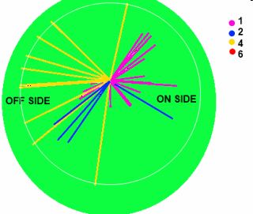
"Wagon-wheel" chart showing where runs were scored in the first part of a cricket game

Slide 22
Processing and Representing
What do we need to think about when representing the data we are planning to use and the results we are hoping to get…
Eg Networks (matrices or arcs and nodes)
Data (graphs and trendlines)
Have a look at the exemplars to get more ideas…
Actual scores: Decision 13/21 (error in algorithm), Data 15/21
Some more ideas on the next page (probably worth referring back to later in the year)

Slide 23
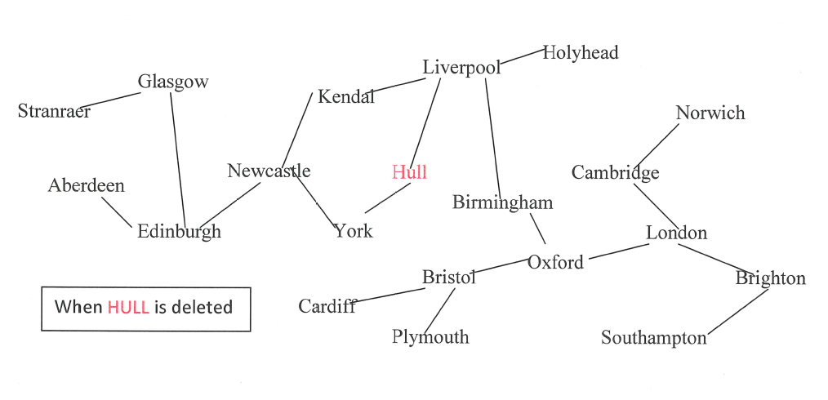
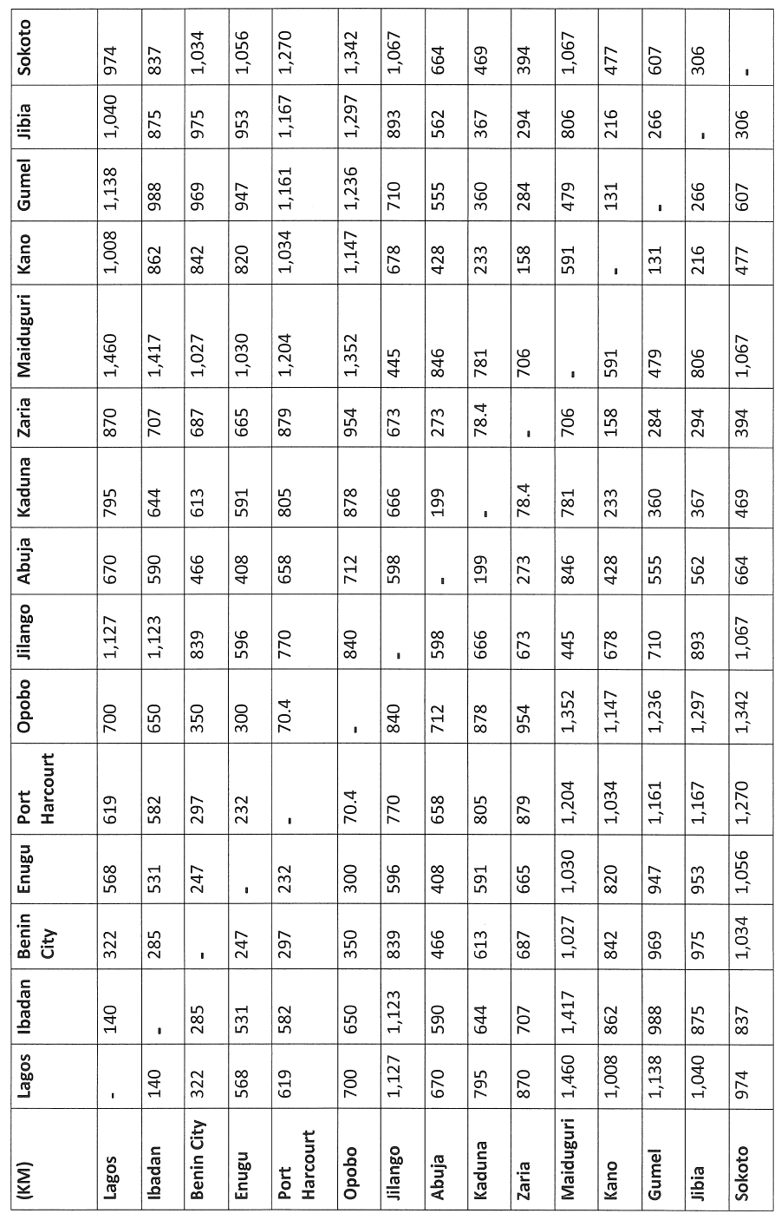
Representing networks
Some examples that may give ideas!

Slide 24
Processing and Representing (Decision)
Networks (matrices)
Can be formatted as a table, but try to make sure all on one page… Consider rotating the table if it is very wide.
Networks (arcs and nodes)
Doesn’t always need to be in geographic positions to make the layout clearer (but you might want a key for any abbreviations for node names)
Networks (in geographic positions)
Important to check if there are any improvements you can make by eye (TSP bounds), and to check that your answer looks reasonable.
Insert a map image into your document, add dots and lines and labels to represent the network. You could delete the map image later if it makes the page too cluttered.

Slide 25
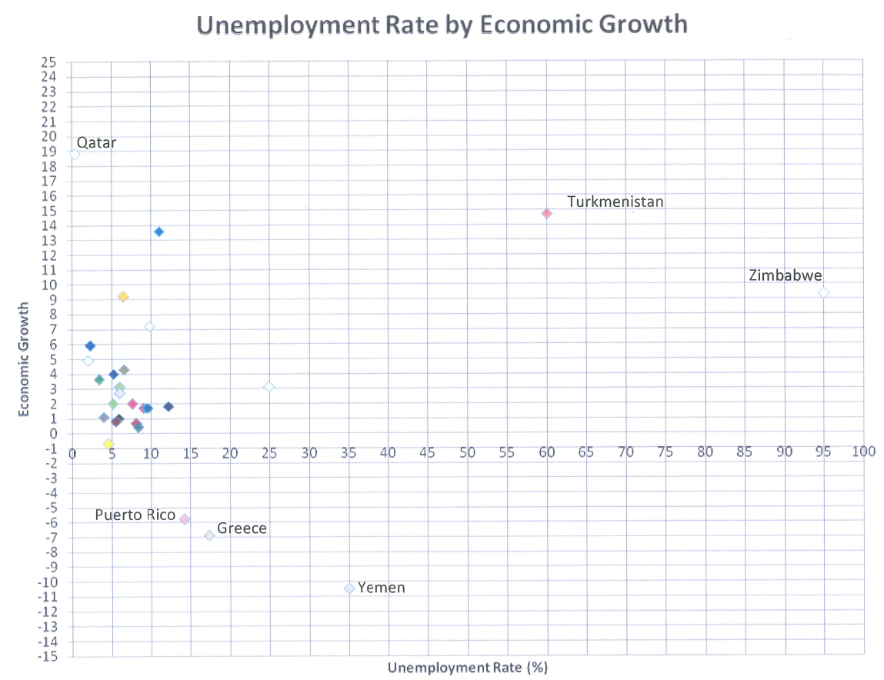
Ideas for representing data

Slide 26
Processing and Representing (Data)
Data (source data)
Tables are good, remember column headings etc
Data (graphs)
Excel or Autograph can help to format neat graphs. Remember to add labels, keys etc as required. Can also be used to calculate and draw lines of best fit etc, but you must give enough evidence to prove that you have also calculated them yourself using formulae in Excel or your calculator.

Slide 27
Processing and Representing
Add notes to your planning sheet about things you need to remember when formatting your coursework and the diagrams and graphs you intend to use.
This powerpoint will be available on Moodle for you to refer back to it later!

Slide 28
Holiday homework
Your holiday homework will include creating a Word file (or equivalent) for your first piece of coursework, in the format described in this powerpoint… You are welcome to start this early!
Your other holiday work will be
Make sure you have at least 2 different ideas sheets fully written up by the first lesson in September,
Collect all of the source data for at least one of the projects. (If one of your ideas needs data collected later in the year eg comparing routes in winter and summer, make that your second project, even though you will have collected half of the data in the summer)

